Slide 1
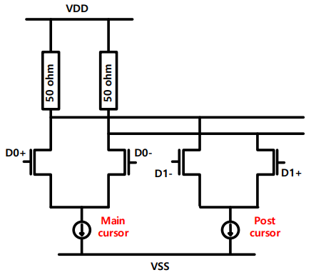
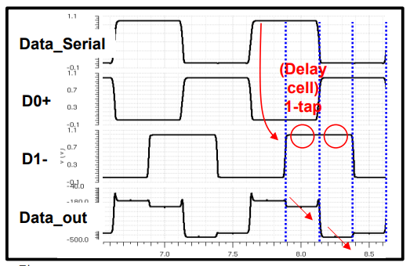
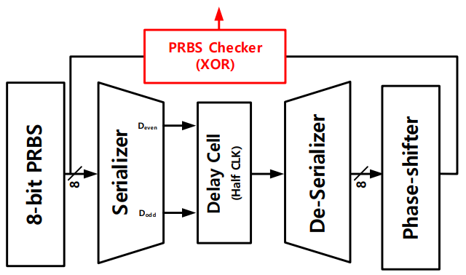
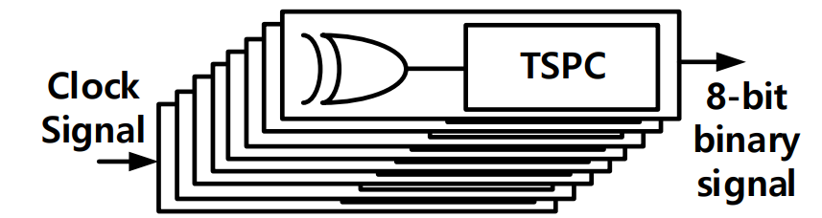
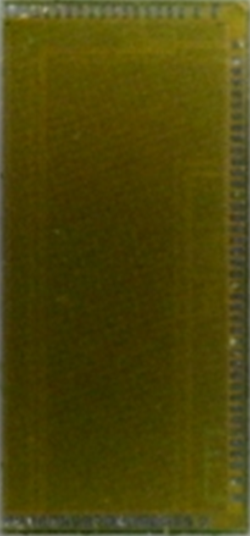
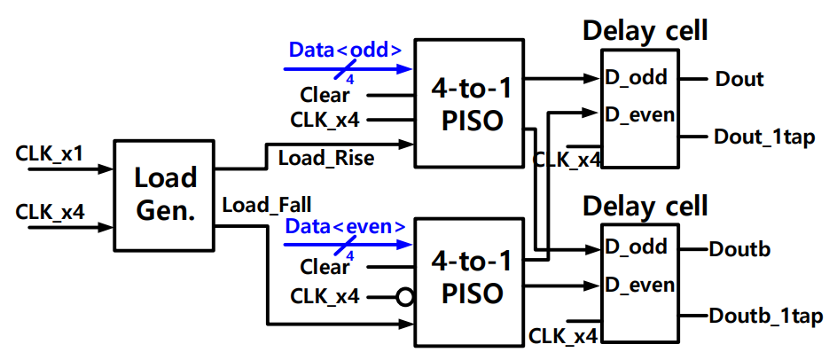
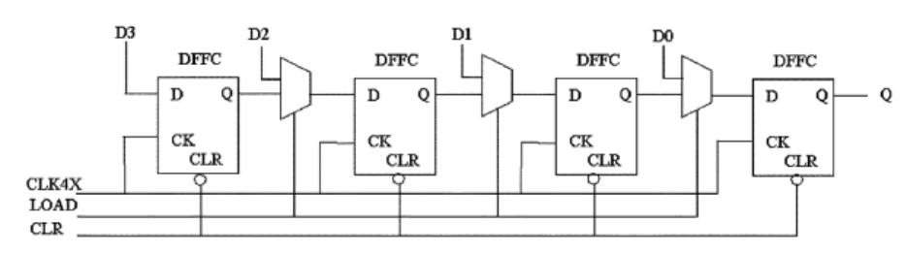
A 16Gb/s NRZ transmitter with 2GHz PLL
in 28-nm CMOS process for MIPI D-PHY
Minhyun Jin, Hohyeon Lee, Kwang Jin Park, Jiwon Kim, Seung Ju Yoon and Soo Youn Kim
Department of Semiconductor Science, Dongguk University
MIPI D-PHY
De-emphasis Equalization
MIPI DPHY outputs 4-lane data output and clock as a display, signals are transmitted using one physical line different from the existing interface.
This paper proposes a 16Gb/s NRZ transmitter for MIPI D-PHY, a data driving verification circuit and a 2 GHz on-chip PLL for clock generator.
4Gb/s NRZ transmitter
PRBS & PRBS Checker
Summary
All systems operate through the 2GHz clock signal through the built-in PLL, and the designed 8-bit pseudo random binary sequence (PRBS) generates 500 MHz of parallel data. The transmitter transmits 4Gb/s of data per line.
In order to compensate for the Inter-symbol interference(ISI) occurring between channels, a de-emphasis type equalizer was designed to increase the time and voltage margin of the transmitter.
Dual Data Rate Serializer & PISO
TX Driver &
PRBS Checker
PLL
Among various interfaces, a 16Gb/s transmitter was designed for MIPI D-PHY, and 250 MHz of parallel data was successfully driven at 4Gb/s per line.
According to the simulation results, power consumption of 0.611 mW/Gb/s is achieved at the 28 nm CMOS 1V supply voltage level.
The chip fabrication and EDA tool were supported by the IC Design Education Center(IDEC), Korea.

